Slide 1






IITM PRAVARTHAK TECHNOLOGIES
pg_check
Alan Mathew Varghese - R6B08
Anna Tomson - R6B17
Aromal A J - R6B21
Arya Rajeev - R6B23

Slide 2



Purpose
Improve data integrity and security by implementing:
Index Integrity Check Password Policy Validation History Tracking Automation & Alerting mechanisms

Slide 3
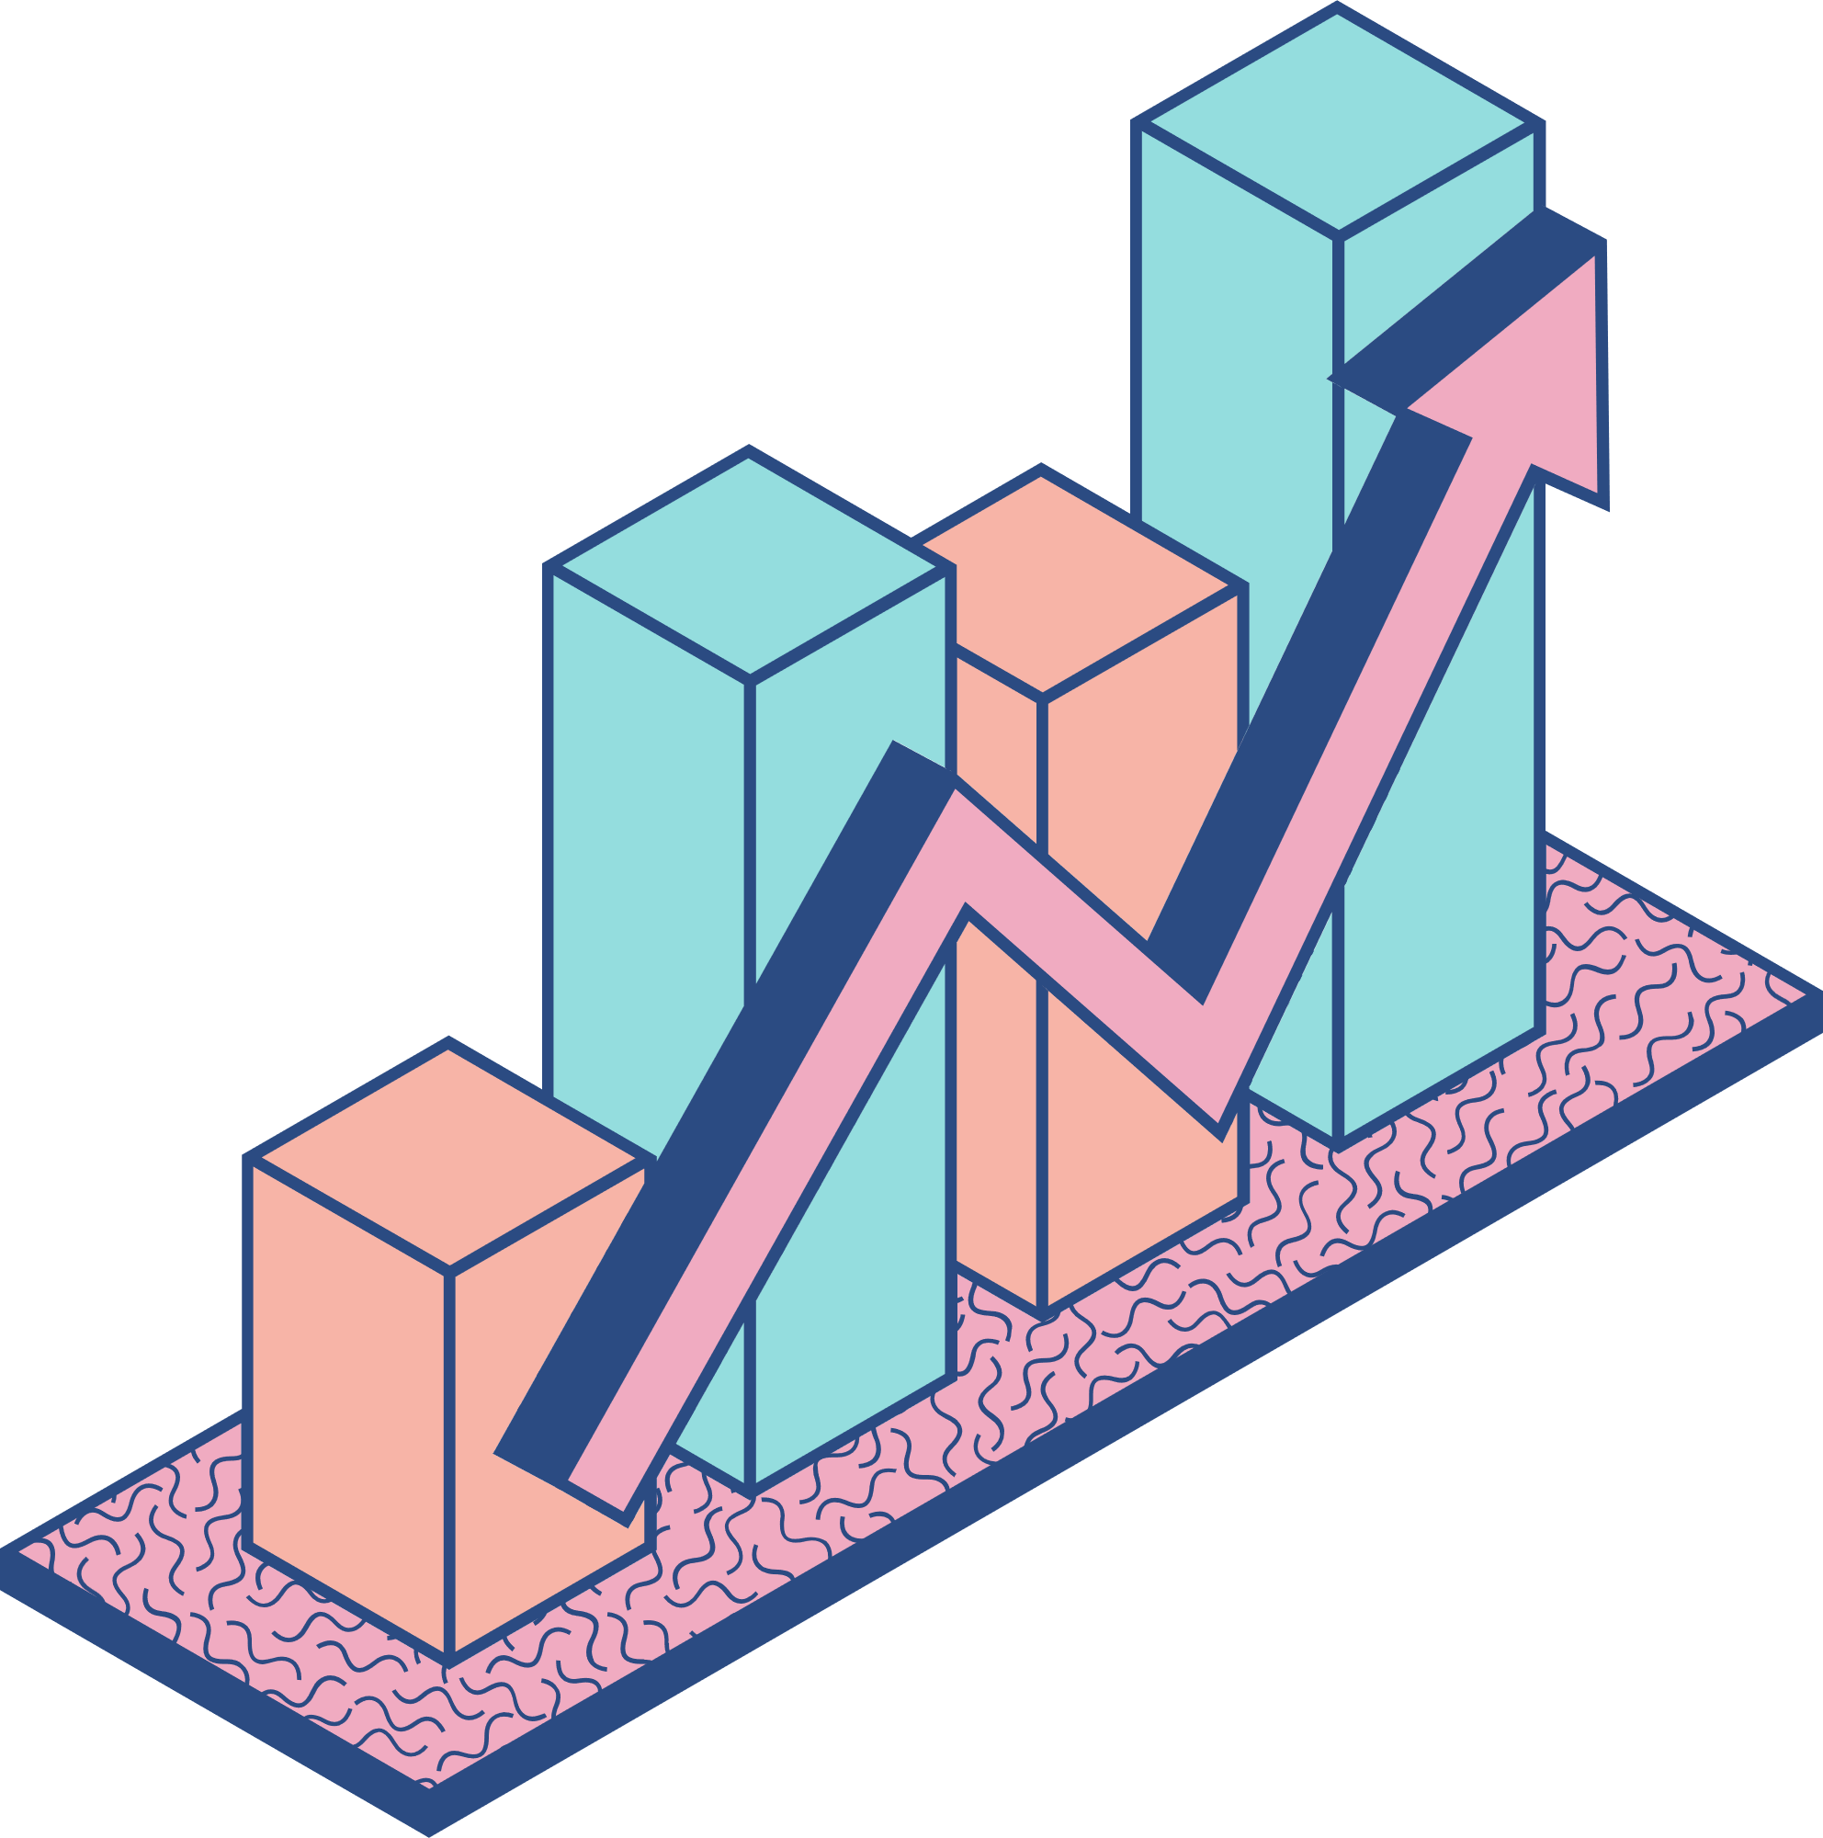
Problem
Statement

Slide 4

Existing Issues in pgCheck
Limited customization
Reactive functionality
Lack of advanced reporting and visualization tools
Minimal integration with third-party tools

Slide 5
Possible Enhancements
Enable real-time monitoring
Introduce customizable configurations
Add advanced visualizations and recommendations
Integrate with external platforms

Slide 6
Product Functions
Index Integrity Check
Password Policy Validation
History Tracking
Automation and Alerting

Slide 7
Product Perspective
Enable real-time monitoring
Introduce customizable configurations
Add advanced visualizations and recommendations
Integrate with external platforms

Slide 8
System
Features

Slide 9
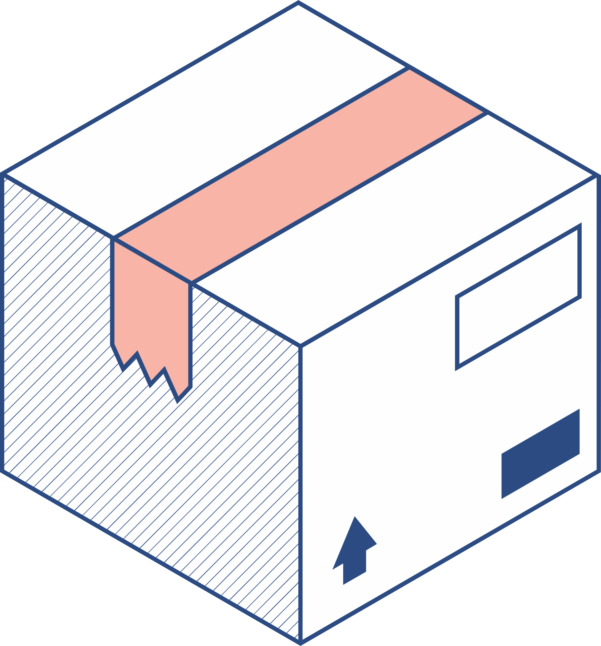


Index Integrity Check
Functional Requirements The system must scan indexes periodically. If an index is corrupted, the system must log an alert. The system should provide recommendations for index optimization. Support manual and automated integrity checks.

Slide 10
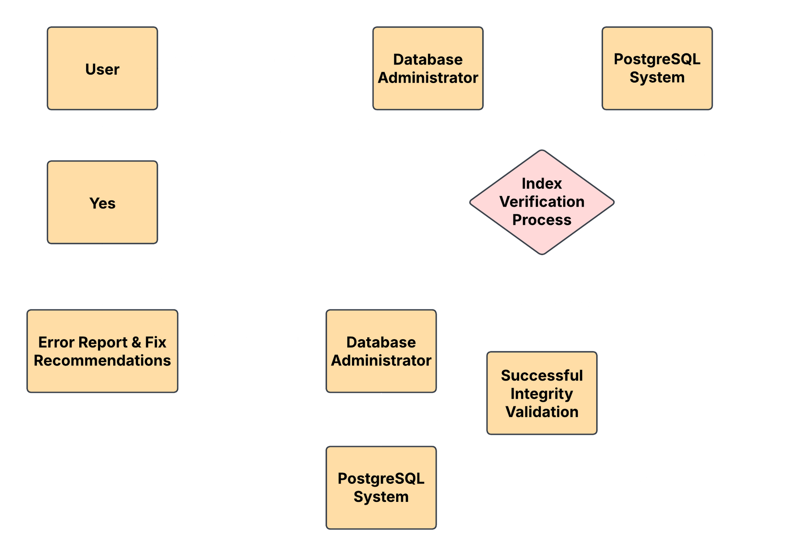
A C T I V I T Y

Slide 11
Password Policy Validation
Functional Requirements Passwords must be at least 12 characters long. Passwords must include uppercase, lowercase, numbers, and special characters. Passwords must expire every 90 days. Users must not reuse any of their last 5 passwords. Failed login attempts should trigger account lockout after 5 tries

Slide 12
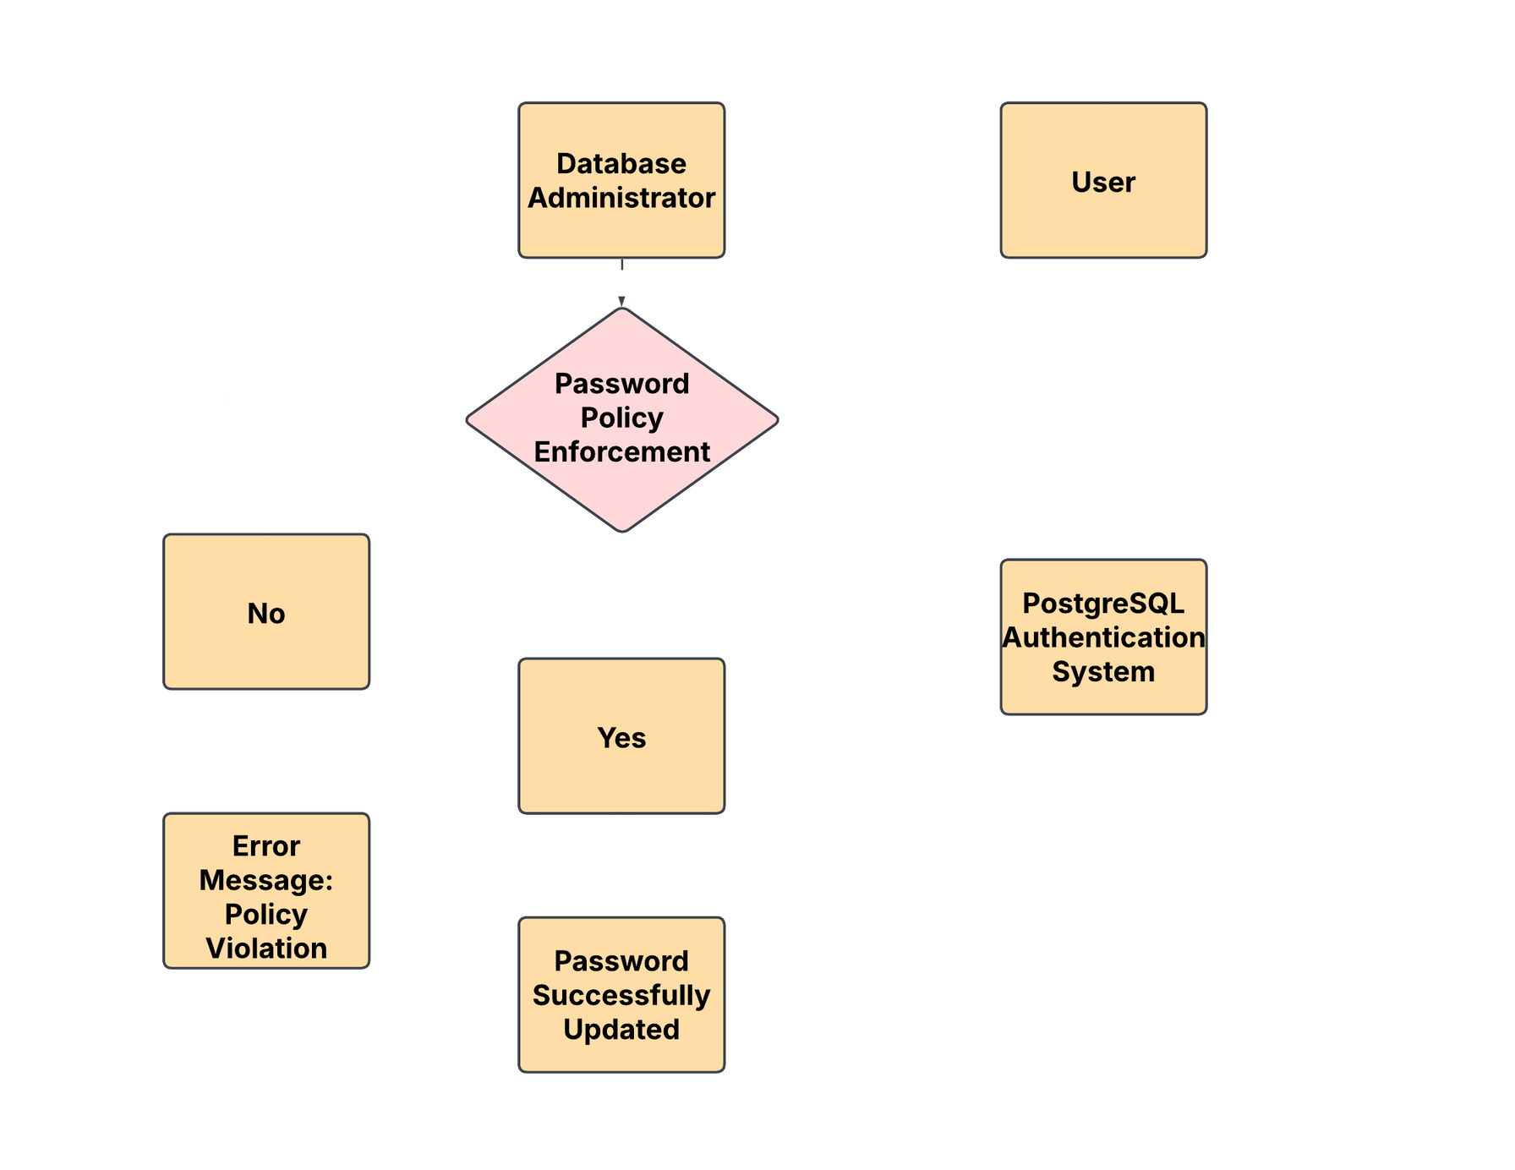
A C T I V I T Y

Slide 13
History Tracking
Functional Requirements The system must log health-check results over time. The system should generate reports on historical trends. The system must provide visual analytics for trend monitoring.

Slide 14
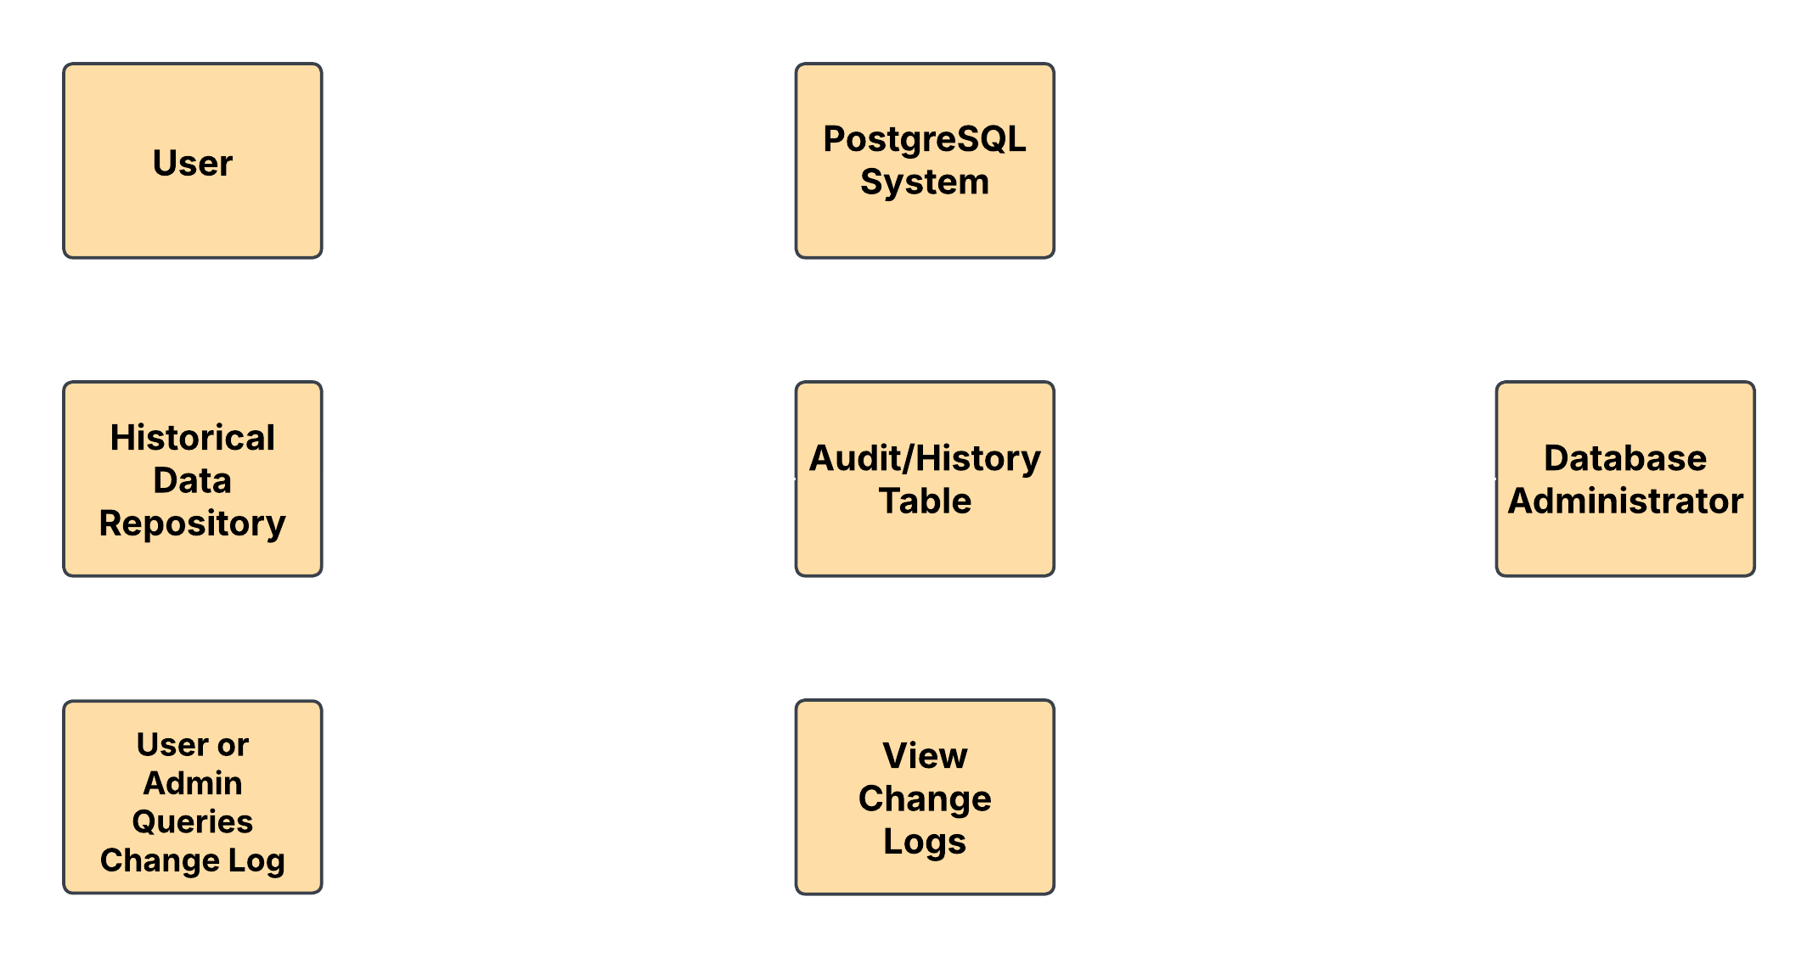
A C T I V I T Y

Slide 15
Automation and Alerting
Functional Requirements The system must schedule automated health checks. The system should generate daily/weekly health reports via email or webhooks. The system must enable user-defined thresholds for triggering alerts. The system must integrate with monitoring tools like Prometheus, Grafana, or Zabbix.

Slide 16
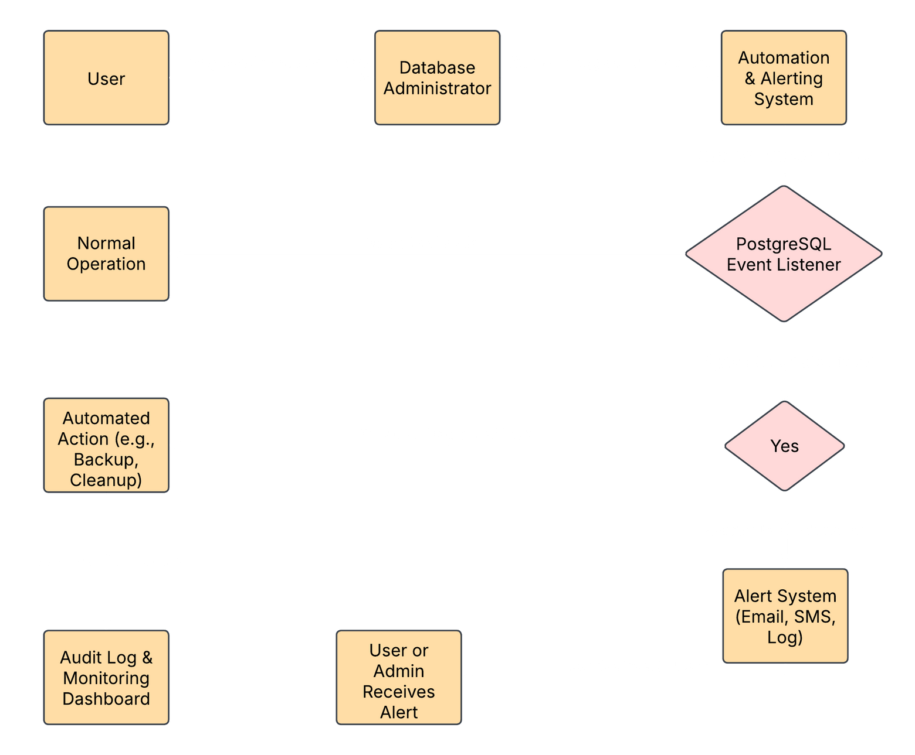
A C T I V I T Y

Slide 17


Nonfunctional Requirements
• Performance: Minimal impact on database performance.
• Security: SCRAM-SHA-256 hashing for passwords.

Slide 18
Timeline
1
2
3
PHASE
PHASE
PHASE
Requirements gathering and design.
Development and initial testing.
Deployment and user training.

Slide 19

Conclusion

Slide 20

Do you have any questions?

